Slide 1
Exploratory Data Analysis
LISUM19
21-Mar-2023

Slide 2
Background –G2M(cab industry) case study
XYZ is a private equity firm in US. Due to remarkable growth in the Cab Industry in last few years and multiple key players in the market, it is planning for an investment in Cab industry.
Objective : Provide actionable insights to help XYZ firm in identifying the right company for making investment.
The analysis has been divided into four parts:
Data Understanding
Forecasting profit and number of rides for each cab type
Finding the most profitable Cab company
Recommendations for investment

Slide 3
Data Exploration
24 Features( including 9 derived features)
Timeframe of the data: 2016-01-31 to 2018-12-31
Total data points :355,032
Cab_Data.csv
Customer_ID.csv
Transaction_ID.csv
City.csv
USholiday.csv
Assumptions:
Outliers are present in Price_Charged feature but due to
unavailability of trip duration details ,we are not treating this as outlier.
Final cab data
Profit of rides are calculated keeping other factors constant and only Price_Charged and Cost_of_Trip features used to calculate profit.
Users feature of city dataset is treated as number of cab users in the city.
we have assumed that this can be other cab users as well(including Yellow and
Pink cab)

Slide 4
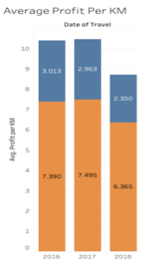
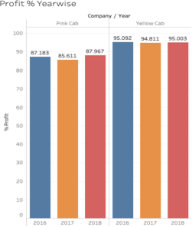
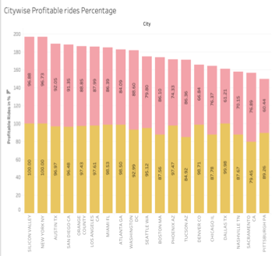


Profit Analysis
Profit Analysis
Company | Profit | Total Rides | Profit Per Ride
Pink Cab | 5,237,540 | 83,825 | 62.48183716
Yellow Cab | 43,251,775 | 271,207 | 159.4788298

Slide 5
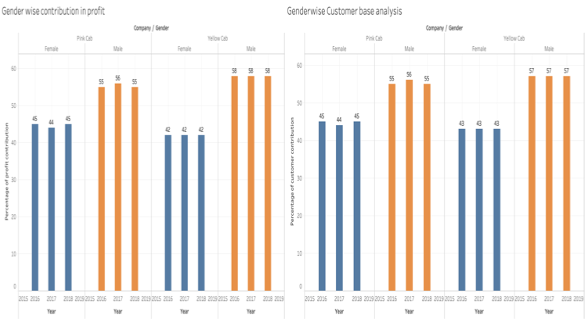

Profit and customer base Analysis Gender wise
There is almost equal distribution of gender in the Profit and
customer base of
both the cabs.

Slide 6
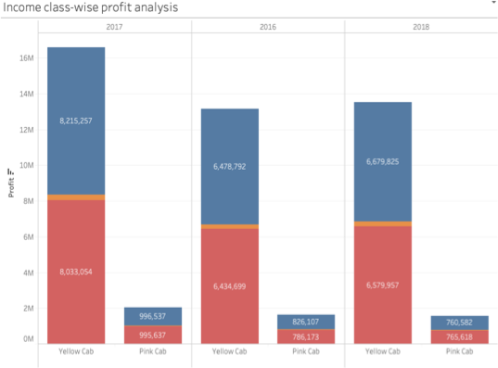
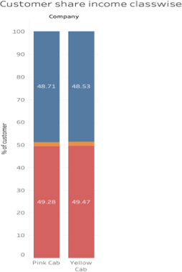

Income Class wise Profit and customer base Analysis
Middle class and high class contributes
more in the profit as well as
in the customer
base of both the cabs

Slide 7

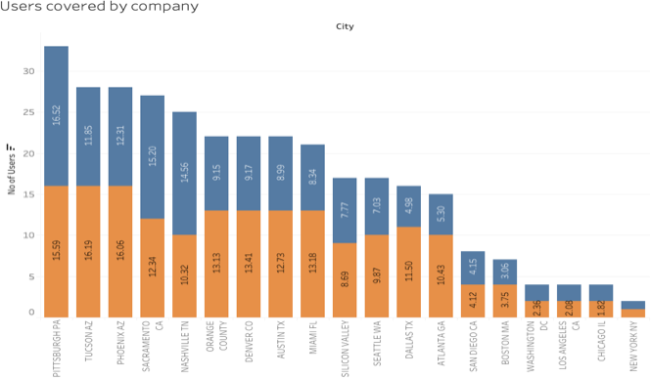
City Wise Cab Users Covered By Company
This is the number of users covered by Yellow and Pink cab In the city against
all cab users present In the city

Slide 8
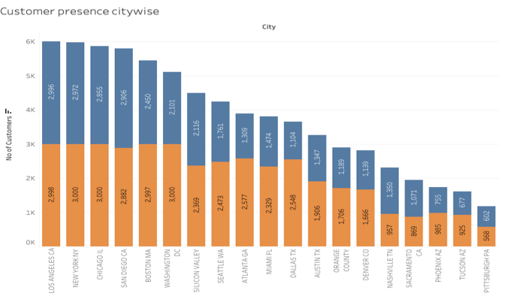

Customer Presence of Yellow and Pink cab city wise
Out of 19 Cities Pink cab have higher customer reach as compared to Yellow cab ,in following 4 cities:
SanDiego
Nashville
Sacramento
Pittsburgh

Slide 9
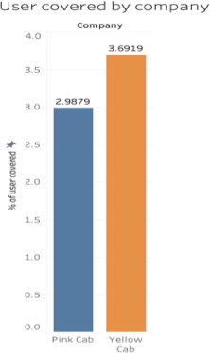
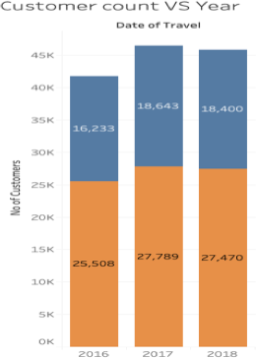

User Covered by Company and Customer base Year wise
Yellow cab has reach of around 3.7% cab users while Pink cab has 2.9% reach.
We have considered all cab users present in 19 cities to
calculate Yellow and Pink cabs coverage.
Yellow cab higher customer base as compared to Pink cab.
There is 1.3% loss in customer count of Pink cab from 2017- 2018 and for the same period Yellow cab lost 1.14%

Slide 10


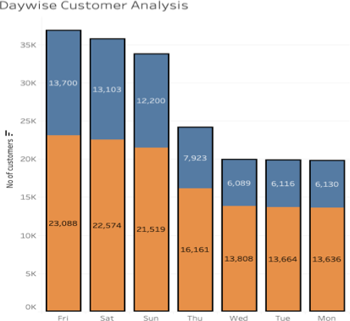
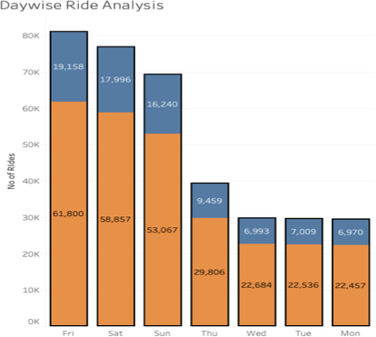
Customer And Ride Analysis Day Wise

Slide 11

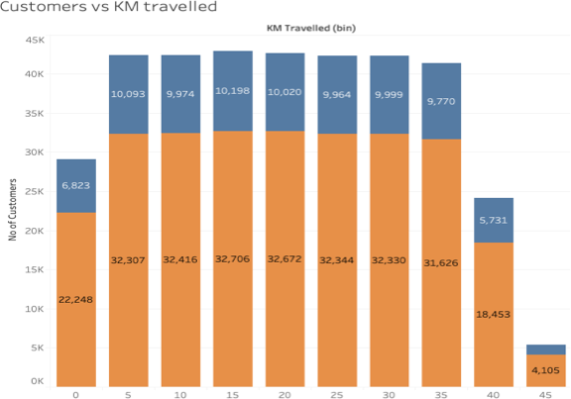
Customer analysis based on ride distance
Yellow cab has customers almost uniform
for short, medium and long Trip. Which shows yellow cab
is offering better customer plan for short, medium and
long Trip.
5-35 KM trips are contributing more In both the cabs profit
There is a huge difference between yellow and pink cab in customer reach for short and long trip. Yellow cab has very good customer reach in
this segment as well

Slide 12
Recommendations
We have evaluated both the cab companies on following points and found Yellow cab better than Pink cab:
Customer Reach : Yellow cab has higher customer reach in 25 cities while Pink cab has higher customer reach in 4 cities. We have also observed that Yellow cab is doing good in covering other cab users as compared to Pink cab.
Customer Retention: We have analyzed this in two segments : at least 5 drive and at least 10 drive with the same cab company. And we found that Yellow cab is doing far better than Pink cab in both these segments.
Average Profit per KM: Yellow cab’s average profit per KM is almost three times the average profit per KM of the Pink cab.
Income wise Reach :Both the cabs are very popular in high and medium income class but here also Yellow cab is performing better than Pink cab in offering their services to all the three income class group (low, medium and high)
Ride count and Profit Forecasting : Both the companies are facing loss in the profit and no. of ride. Yellow cab’s forecasted profit loss
is around 1.83% while Pink cab’s loss in 3.1%.Pink cab is facing more loss even when its forecasted no of ride loss is lesser than Yellow cab.
On the basis of above point , we will recommend Yellow cab for investment.

Slide 13

Thank You

